Slide 1
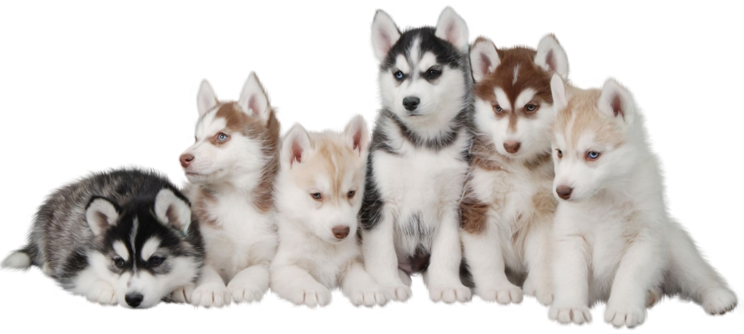

The future of pets who find themselves in shelters
By Desi Marvakov & Ben Shamritz

Slide 2
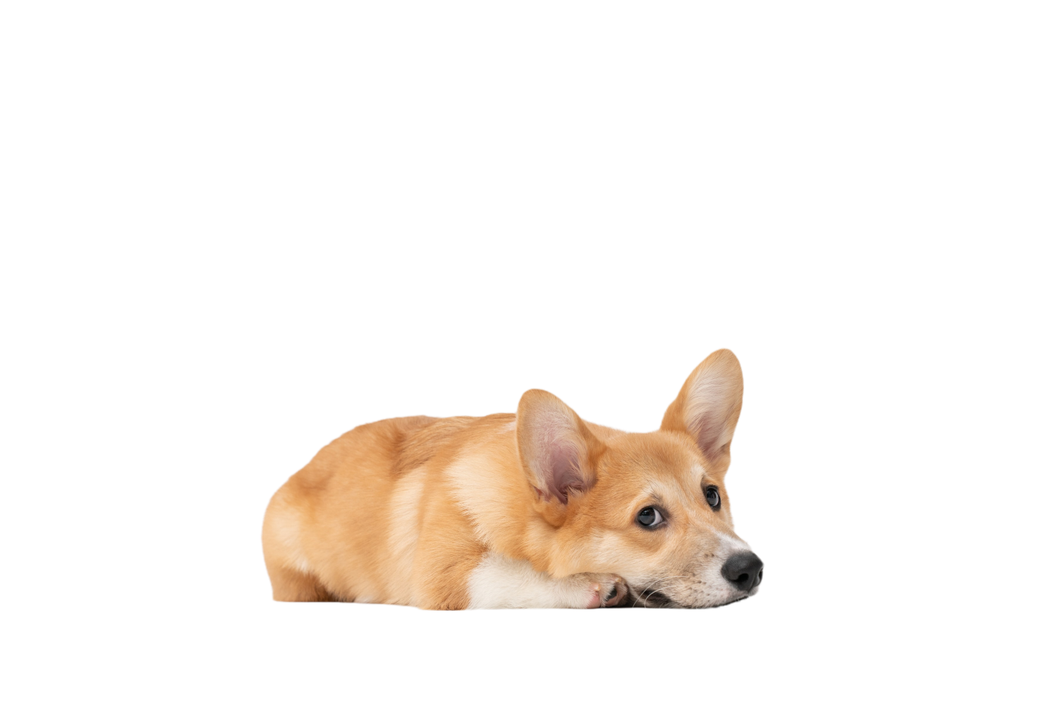
Shelters in Numbers
Of the approximately 6.5 million companion animals who enter shelters in the US every year, approximately 3.3 million are dogs and 3.2 million are cats.
Each year, approximately 1.5 million animals are euthanized (670,00 dogs and 860,000 cats).
Approximately 3.2 million shelter animals are adopted each year (1.6 million dogs and 1.6 million cats).
About 710,000 animals who enter shelters as strays are returned to their owners (620,000 dogs and 90,000 cats).
Of the dogs entering shelters, approximately 48% are adopted and 20% are euthanized
Of the cats entering shelters, approximately 50% are adopted and 27% are euthanized
About twice as many animals enter shelters as strays compared to the number that are relinquished by their owners.
Link

Slide 3

Predicting pets’ stay in shelter
Finding the main causes for pets' abandonment
Finding the ratio between intakes and outtakes of shelters
With hope of preventing the next case..

Slide 4
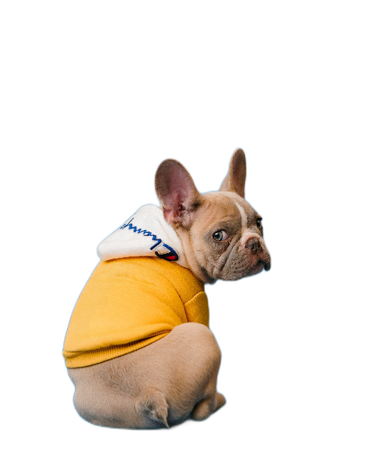
The Dataset
Animal id – the id an animal gets when taken in shelter (if an animal get to shelter more than once the id remains the same)
Name – the pet’s name
Intake type – stray, public assist, owner surrender, euthanasia request.
Intake condition – normal, injured, aged, sick, other ,feral, pregnant, nursing.
Outcome type - adoption, died, disposal, euthanasia, missing, relocate, returned to owner, RTO adopt, transfer.
Breed.
Sex upon intake/outcome – either the animal is neutered, spayed or intact.
Age upon intake/outcome – the age of a pet when it entered the shelter and left the shelter.
Color.
Time in shelter – duration of time the animal spent in shelter.
Austin animal center data set (intakes & outcome):
Columns – 41
Rows – 79,673

Slide 5

Cleaning Data
Removing Duplicated rows (keeping the first row of the duplication).
Removing irrelevant columns.
Completing missing values – in sex and age upon outcome columns we filled a few missing values in order to be able to use dummies.
reducing value types by grouping values with the same properties under the same label (as breed type, color purity, gender and age groups).
Converting text into binary values (for dummies/linear regression).
Removing blank data.

Slide 6

Visualization

Slide 7

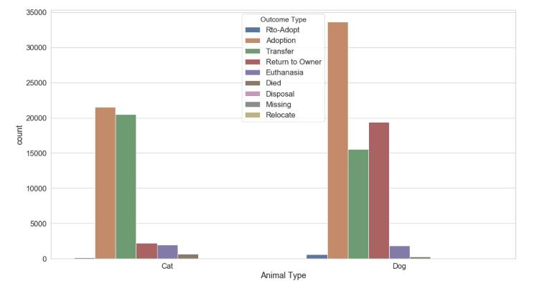
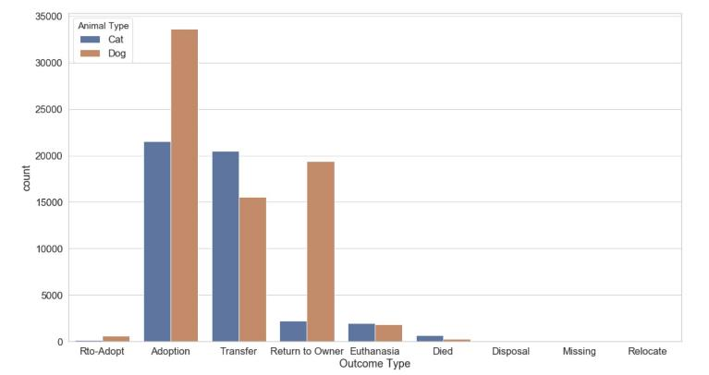
Those two bar plots represent the distribution between cats’ and dogs’ outcome types
In both bar plots we can see each pet outcome by amount. It is encouraging to know that most
Pets are getting adopted or returned to their owners. We can also see that a big amount of them
Are getting transferred, which is problematic because we can not know what happens after the transfer.
Some might find a new home, and some might find themselves back in shelter.

Slide 8
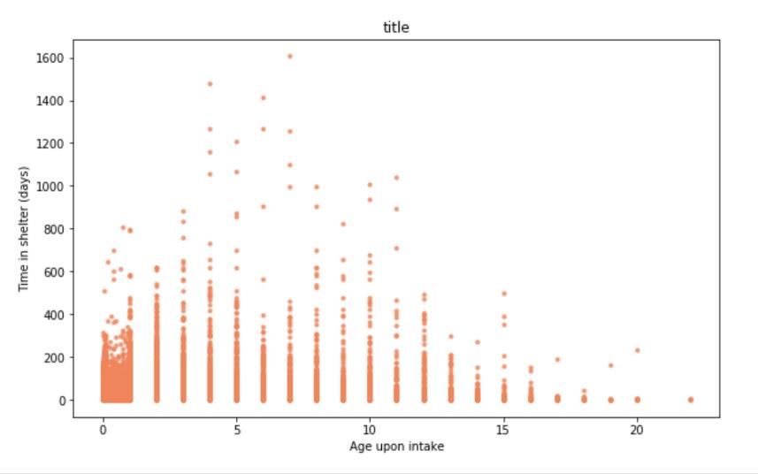
In order to answer our second question, we were curious to see if there is a direct correlation between the pets’ age and the time spent in shelter .
As we can see from this graph, age has no effect on the time spent in shelter.
While most of the data points are gathered between the ages of 0-2, it appears that time in shelter is mostly
ranged between 0-200 days for the various ages.

Slide 9
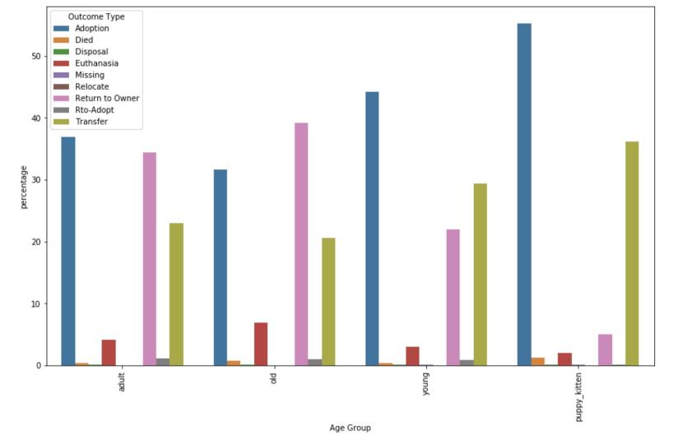
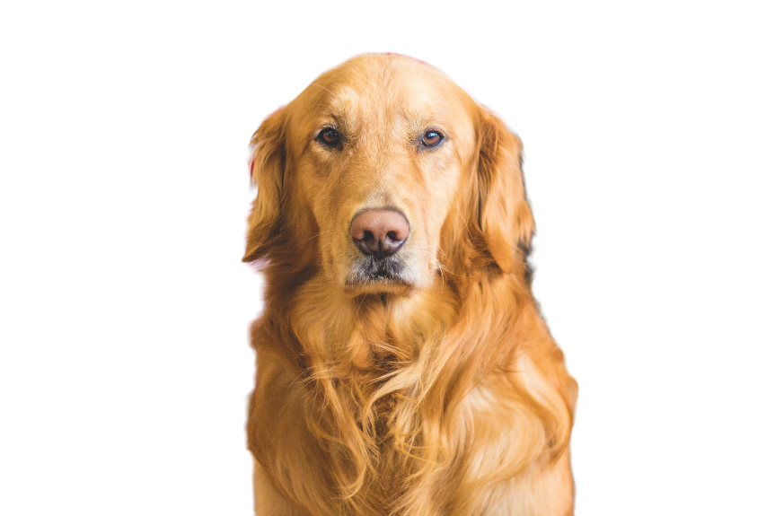
For better understanding, we divided the pets to groups
by ages :
Puppy / Kitten – from newborn to the age of 1 year old
Young – between 1 year to 3 years old
Adult – between the ages 3 – 6 years old
Old – older then 6 years old
The graph represents the outcome type for each
age group by percentage

Slide 10
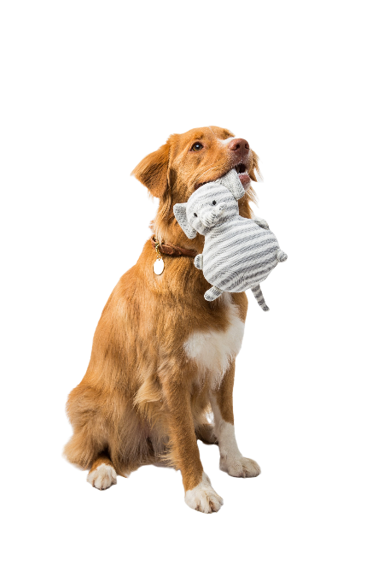
Machine Learning

Slide 11
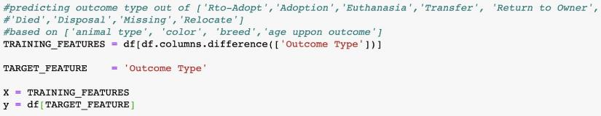
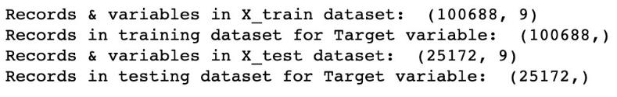
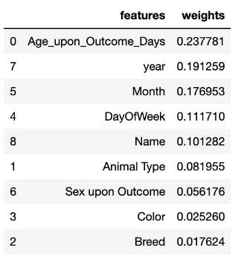
Predicting outcome type – Random Forest
We trained a random forest model while trying to predict the “outcome type” column (classification problem). The training dataset included 9 columns and 100,688 rows. The test dataset included 9 columns as well and 25,172 rows. The accuracy we got from the prediction of the test data is 0.672.
We can also see from the feature importance table that “age upon outcome” had the highest importance of 0.23.
We also tried finding the best “n_estimators” (number of trees in the forest) and found out that the best one is 50 and its score was 0.66.

Slide 12
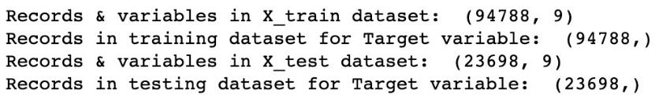
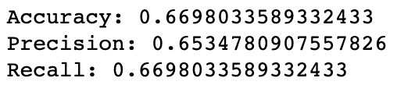

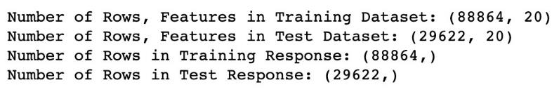
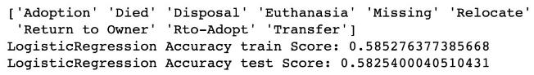
Predicting outcome type – Logistic Regression
We tried building two different logistic regression models,
On the first model we encoded the features that were represented by strings , followed by training the model and receiving accuracy of 0.67.
On the second model we tried using “dummies” (instead of encoder) which brought us an accuracy of 0.58.

Slide 13

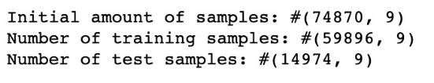
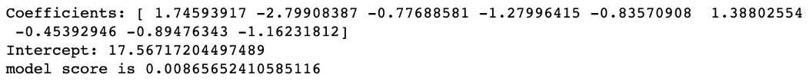
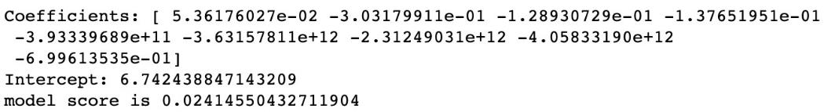
Predicting Number of days in shelter – Linear Regression
We tried building two different linear regression models,
On both models we used “dummies” and StandardScaler.
On the second model we tried cleaning the outliers with using IQR.
We can see that after excluding the outliers our model score went to 0.024 which still means there is no linear correlation.

Slide 14
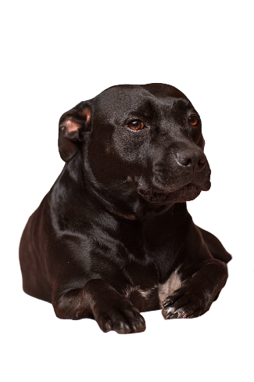
To sum up,
Trying to predict an animal stay in shelter was impossible while taking to account many different features, even with the try of ignoring several features the model had a low score.
For example, taking into consideration a pets’ age and its stay in shelter we got an average of 200 days for every age group (there was no linear correlation).
we learned that most of the pets who end up in shelter are stray pets and are mostly young (under the age of 3 years old).
The only age group that had more than 50% of being adopted are the puppy and kitten group (pets under the age of 1)
On our future work we would like to expand our research with additional datasets that explains more thoroughly abandonment reasons in order to predict which owner would be a good fit.

Slide 15

External Resources
The city of Austin, Texas website
The American Society for the Prevention of Cruelty to Animals
Unsplash (pictures source)

